Slide 1

TEMPLATE EXECUTION SOFTWARE
Presented by:-
Jampala Triveni
Errabelly Archana
Motapothula Vyshnavi Under the guidence of
Thatikonda Lavanya Debashree Mishra
Vadisa Gayathri

Slide 2
TEAM MEMBERS
NAME | EMPLOYEE NUMBER
JAMPALA TRIVENI | 46281047
ERRABELLY ARCHANA | 46281039
MOTAPOTHULA VHYSHNAVI | 46282014
THATIKONDA LAVANYA | 46282012
VADISA GAYATHRI | 46281049

Slide 3
CONTENTS
Tools and Contribution
Introduction
What is template and placeholder
Diagramatic Representation
Output
Reference

Slide 4
TOOLS & CONTRIBUTION
Tools :-
Ubuntu Linux as platform.
C languge
Makefile is use for compilation.
Gcov is used to check code coverage.
Valgrind to find memory leaks.
Splint is used for static analysis.
GCC is an optimizing compiler
Jampala Triveni - Coding Skeleton& Code Unit Test Cases
Errabelly Archana- Coding Skeleton& Code Unit Test Cases
Motapothula Vyshnavi - Coding Unit Test Cases& Update Of UT&IT Document
Thatikonda Lavanya - Update Of UT&IT Document &Editing Design Document
Vadisa Gayathri - Editing Design Documents & MOM

Slide 5
INTRODUCTION
The project is to implement a Template Execution Software (TES), where template means a file having some placeholder variables, whose values are fetched from other files. A typical invocation might be a given a template file and a number of data files, resulting in formation of output files corresponding to each data file.

Slide 6
What is template
A template is a simple yet very powerful tool in . The simple idea is to pass data type as a parameter so that we don’t need to write the same code for different data types. For example, a software company may need to sort() for different data types.
What is placeholder
A Placeholder is simply a variable that we will assign data to at a later data.It allows us to create our operation and build our computation graph,with out needing the data.

Slide 7
DIAGRAMATIC REPRESENTATION
Template Execution Software
Here we have to create template file
And multiple data files in data.csv
Load the template file here we placing the placeholder variables
Load the multiple data Files here we storing variable and value pairs
We have replace the variable with values. Here old word is replaced with new word
Here we can Extract the tokens
This helps to complete the process in less time
Process replacement function which helps to continue the process in the loop manner .it is because we using multiple data types

Slide 8
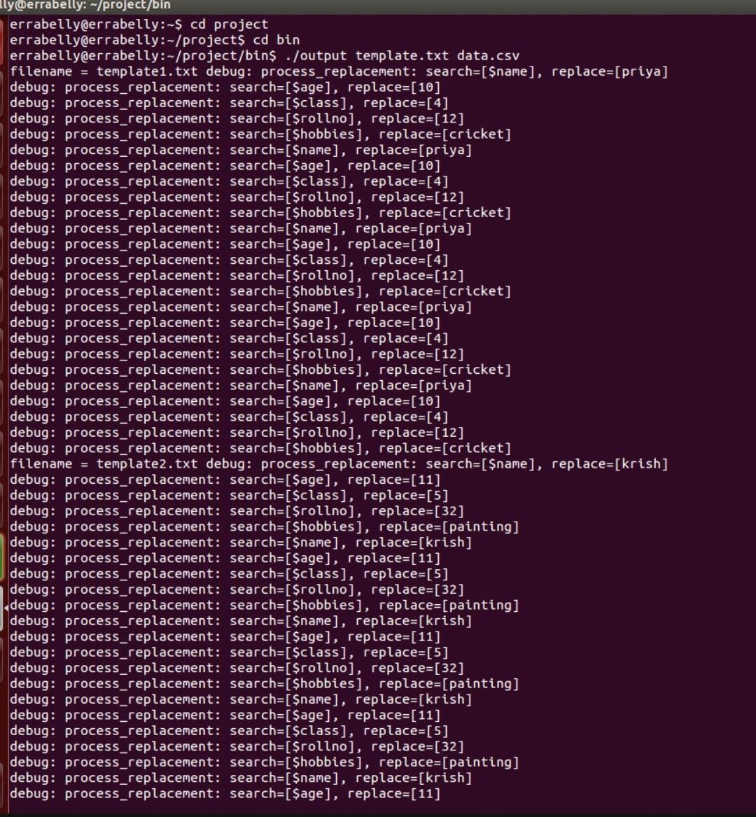
OUTPUT:

Slide 9
REFERENCES
TEMPLATE:
https://developer.hashicorp.com/terraform/language/functions/templatefile
Place holders:
https://www.databricks.com/tensorflow/placeholders
Make multiple file:
https://youtu.be/0RBdYb2OGoo

Slide 10


